Slide 1

VAM-HRI 2020
3rd International Workshop on Virtual, Augmented, and Mixed Reality for Human-Robot Interactions
Collocated with HRI ∙ Cambridge, UK ∙ March 23

Slide 2

Call for Papers ∙ VAM-HRI 2020
3rd International Workshop on Virtual, Augmented, and Mixed Reality for Human-Robot Interactions
Collocated with HRI ∙ Cambridge, UK ∙ March 23
At VAM-HRI we seek to bring together HRI, Robotics, and AI researchers working on challenges in mixed reality interactions between humans and robots. VAM-HRI 2020 is looking to follow on the success of the last two years, and welcomes contributions on VR/AR/MR topics including, but not limited to:
Novel HRI problems that can benefit from AR/VR/MR
Intention communication, explanation of behaviors
Robot testing and diagnostics
Human-subject experimentation
Efficient representations for AR/VR/MR interaction patterns
AR/VR/MR language grounding AR/VR/MR-augmented natural language generation
AR/VR/MR-enabled robot control
Architectures for AR/VR/MR-based HRI
AR/VR/MR for expanding social interactions
SUBMISSIONS DEADLINE: January 30, 2019
FULL PAPERS: 6-8 page papers presenting novel work.
ABSTRACTS: 2-4 page papers presenting previous, current, or proposed work.
NOTIFICATION DEADLINE: Before HRI Early Registration
Organizing Team
Tom Williams Mines
Dan Szafir UC Boulder
Tathagata Chakraborti IBM Research
Ong Soh Khim U Singapore
Eric Rosen Brown
Serena Booth MIT
Thomas Groechel USC
For more information, visit: http://vam-hri.xyz/

Slide 3
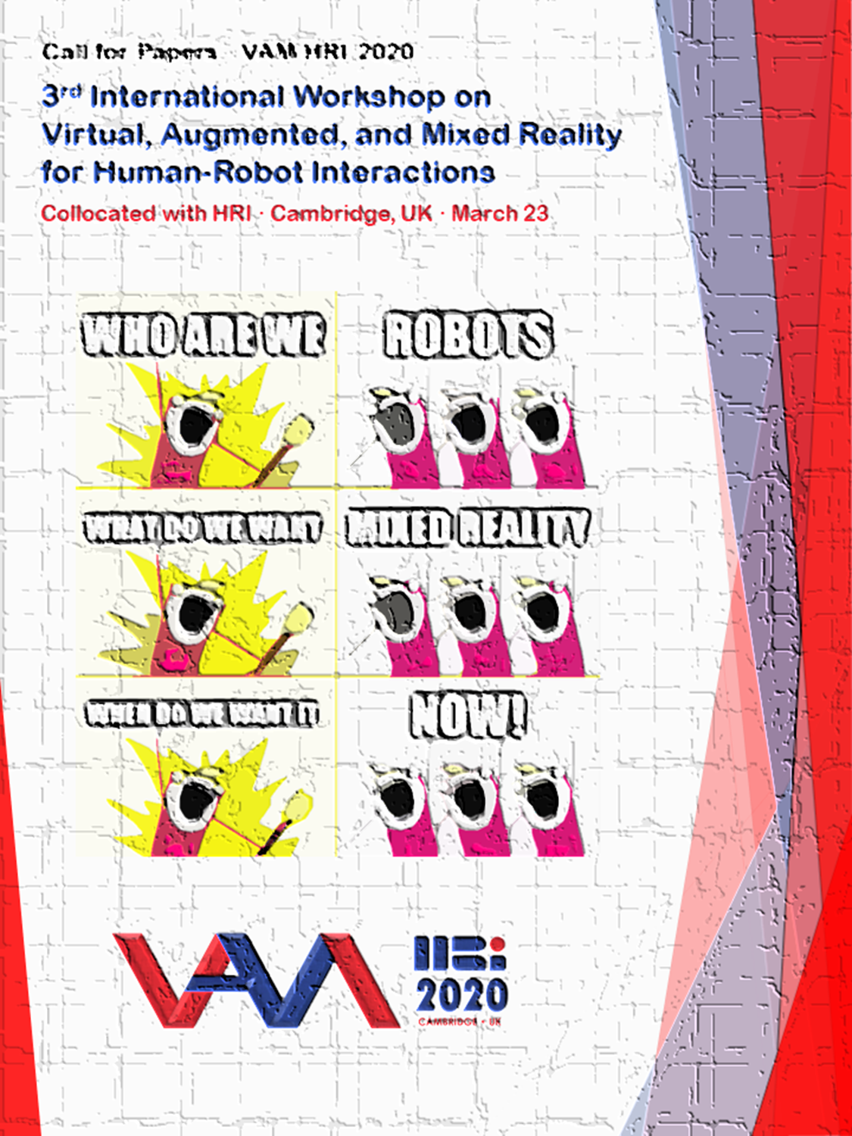

Papers due Jan 30, 2020 ∙ Visit http://vam-hri.xyz/

Slide 4
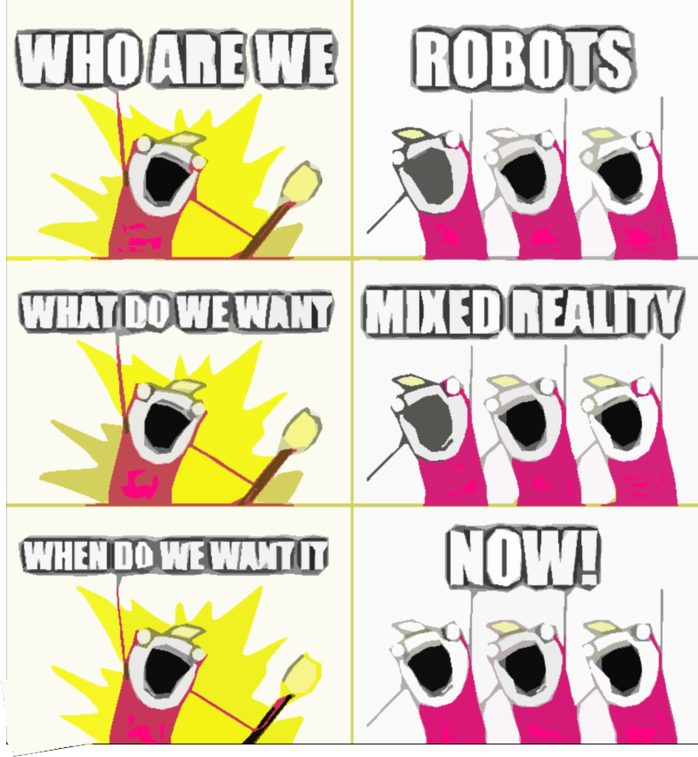

Call for Papers ∙ VAM-HRI 2020
3rd International Workshop on Virtual, Augmented, and Mixed Reality for Human-Robot Interactions
Collocated with HRI ∙ Cambridge, UK ∙ March 23

Slide 5






[CFP] 2nd International Workshop on Virtual, Augmented and Mixed Reality for Human-Robot Interaction
Collocated with HRI 2019, Daegu/Korea
At VAM-HRI we seek to bring together HRI, Robotics, Artificial Intelligence, and Mixed Reality researchers to identify challenges in mixed reality interactions between humans and robots. VAM-HRI was held for the first time at HRI 2018, where it served as the first workshop of its kind at an academic AI or Robotics conference, and served as a timely call to arms to the academic community in response to the promise of this emerging field. VAM-HRI 2019 is looking to follow on the success of last year's workshop and present new opportunities for expanding this nascent research community.
Submission Instructions
FULL PAPERS: 6-8 page papers presenting novel work.
EXTENDED ABSTRACTS: 2-4 page papers presenting previous, current, or proposed work.
Submit here → https://easychair.org/conferences/?conf=vamhri2019
Papers will undergo mutual review; as such, authors of submitted papers will be expected to provide a small number of reviews for fellow authors. All accepted papers will be accompanied by talks and/or poster presentations and will be archived on the workshop website.
SUBMISSIONS DEADLINE: January 15th, 2019
NOTIFICATION OF ACCEPTANCE/REJECTION: January 30th, 2019
For more information, visit: http://vam-hri.xyz/

